Slide 1

Coalition Name
Workplace Charging Challenge
Presenter
Title
E-mail
Date
Notes:
[Introduce yourself, the Coalition and other coordinators.]
We know that in this competitive marketplace, your company cares about recruiting and retaining top talent, increasing brand visibility, and ultimately improving your bottom line.
As part of a nationwide network of Department of Energy- supported Clean Cities coalitions, we care about the national, economic and environmental security of our nation and one thing that threatens that is our high consumption of oil. About 7.5 million barrels of oil are imported daily. That means nearly three quarters of a billion dollars goes overseas every single day. About 3 out of every 4 of those barrels of oil are used in the transportation sector. So, to really address this issue, we must focus on reducing petroleum used for transportation. (1)
One way of doing this is by replacing petroleum with a domestic fuel source such as electricity.
For consumers to make the move to an electric fuel source though, the country must build its charging station infrastructure. Having charging stations at the workplace is one key area for installing charging stations.
Today we’re going to discuss how our interests intersect with your interests as a U.S. employer, and how we can engage in a mutually beneficial relationship.
(1) US Census Bureau, Foreign Trade Division, 2014. “US Imports of Crude Oil.” http://www.census.gov/foreign-trade/statistics/historical/petr.pdf
Photo: "To support its corporate car share program and encourage its employees to buy their own PEVs, Google offers free workplace charging at its Mountain View headquarters and several other company locations in the United States." (Photo courtesy Google)
[For Clean Cities’ reference]
Google has 25,000 employees and 300 charging stations across the country. The company’s goal is to provide charging at 5% of its parking spaces.

Slide 2
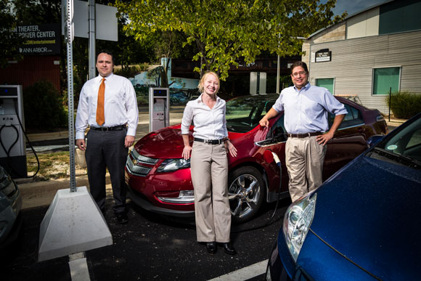
Clean Cities: Who We Are, What We Do
Mission: Advance U.S. energy, economic, and environmental security by supporting local decisions to reduce petroleum use in transportation
Replace
Reduce
Eliminate
Goal: Reduce U.S. petroleum use by 2.5 billion gallons per year by 2020
Notes:
Clean Cities is an initiative of the U.S. Department of Energy that works to reduce, eliminate and replace petroleum usage in vehicles.
The mission of Clean Cities is to advance the energy, economic and environmental security of the United States by supporting local decisions to adopt practices that reduce the use of petroleum in the transportation sector.
Clean Cities has a goal to reduce petroleum consumption by 2.5 billion gallons per year by 2020.
Clean Cities is over 20 years old and during that time we have worked with our communities to:
Save more near 6.5 billion gallons of petroleum
Deploy 775,000+ alternative fueled vehicles
Deploy 6,600 alternative refueling stations
Today’s discussion on plug-in electric vehicles (PEVs) will focus on how we are replacing oil with electricity in our vehicles.
Photo: “Mark Rabinsky (Ann Arbor Clean Cities Coordinator), Heather Seyfarth (Clean Energy Coalition) and Steve Cohen (City of Auburn Hills) pose with a Chevy Volt and Eaton charging stations in their community.” (Photo by Dave Lewinski / Concentrate Media)

Slide 3
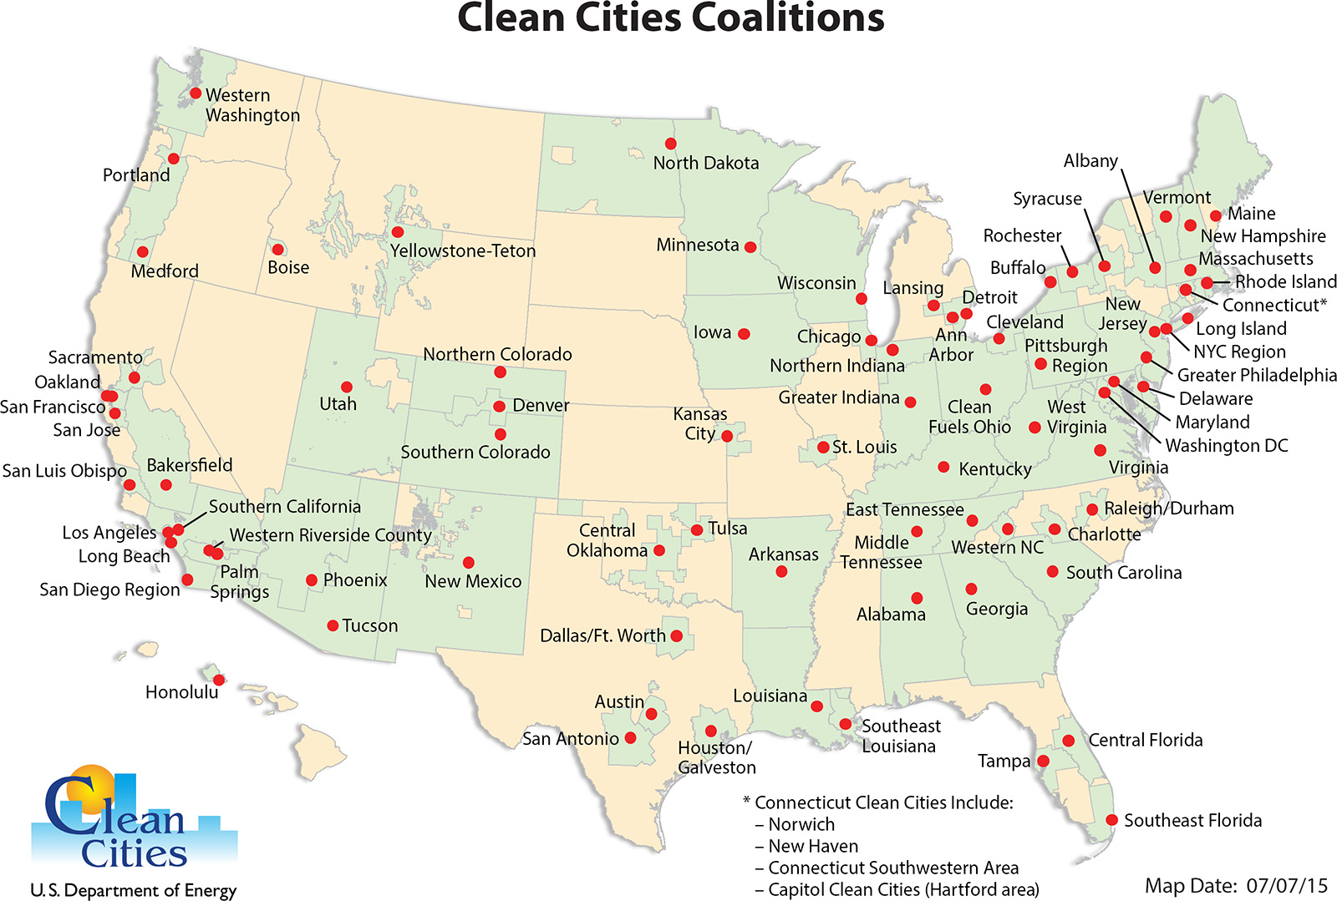
Clean Cities Nationwide Coalition Network
Notes:
Clean Cities’ success results from a network of nearly 100 coalitions nationwide, allowing us to reach approximately 75% of the population and registered vehicles in U.S.
Coalitions are led by local volunteer coordinators and are composed of nearly 18,000 stakeholders including businesses, fuel providers, vehicle fleets, state and local government agencies, and community organizations from both the public and private sectors.
These stakeholders come together to share information and resources, educate the public, help craft public policy, and collaborate on projects that reduce petroleum use.
[Insert information about specific coalition]
(1) US Department of Energy, September 2015. “Clean Cities Logos, Graphics and Photographs” http://www1.eere.energy.gov/cleancities/toolbox/m/logos.html

Slide 4
Goal: Affordable & Convenient Plug-In Electric Vehicles (PEVs)
Notes:
In support of our local efforts to replace oil with electricity in vehicles, the national EV Everywhere Grand Challenge aims to make American-made PEVs that are as affordable and convenient as today’s gasoline-powered vehicles by 2022 (1).
Efforts in support of EV Everywhere consist of:
A technology push of research and development to reduce the cost of PEVs
Charging infrastructure development to enable the convenience of fueling PEVs
PEV education to help consumer acceptance of PEVs and create a market pull
While there are needs in all three of these focus areas, today we’re talking about the opportunity to build our community’s PEV charging infrastructure through the Workplace Charging Challenge.
(1) US DOE, 2013. “EV Everywhere Grand Challenge Blueprint.” http://www1.eere.energy.gov/vehiclesandfuels/electric_vehicles/pdfs/eveverywhere_blueprint.pdf

Slide 5
U.S. PEV Sales Rising
Source: Argonne National Laboratory for US Department of Energy, revised September 2015
Notes:
Workplace Charging Challenge efforts to promote PEVs align with a rapidly growing PEV market
Plug-in electric vehicles are here today- and they can help increase energy security by reducing our dependence on oil, improving fuel economy, lowering fuel costs, reducing maintenance costs, and reducing emissions. With these benefits, we’re seeing consumer excitement, and interest in PEVs is growing.
Through August 2015, more than 350,000 PEVs have been sold since their first introduction over four years ago. In 2014 alone, nearly 120,000 PEVs were sold in the United States, a more than 20 percent increase over 2013 (1).
(1) Argonne National Laboratory for U.S. Department of Energy, September 2015, “Light Duty Electric Drive Vehicles Monthly Sales Updates.” http://www.transportation.anl.gov/technology_analysis/edrive_vehicle_monthly_sales.html

Slide 6
Continued PEV Market Growth
Annual PEV sales and PEVs Available for Consumer Purchase
2011: 17,763 (4 models)
2012: 53,169 (11 models)
2013: 97,102 (16 models)
2014: 118,882 (22 models)
* Tesla Model S Sales Estimated
Source: Argonne National Laboratory for US Department of Energy, revised September 2015
Notes:
Not only is the number of PEVs sold increasing annually, the availability of new models is growing as OEMs develop new technology
When PEVs became commercially available in 2011 there were only 4 models available, and the market was dominated by the Nissan Leaf and the Chevy Volt.
The largest percent increase can be seen in 2012, when PEV sales nearly tripled over the course of a year.
Annual sales took a jump from 2012 to 2013, with an 80 percent increase in sales with only 5 new models released. The Tesla Model S made the largest jump in market share.
In 2014 nearly 120,000 PEVs were sold in the US and the number of available models has increased to 22 different vehicles to choose from. The market share also evened out 2014 with the addition of a new model form BMW (1).
(1)( Argonne National Laboratory for U.S. Department of Energy, September 2015, “Light Duty Electric Drive Vehicles Monthly Sales Updates.” http://www.transportation.anl.gov/technology_analysis/edrive_vehicle_monthly_sales.html

Slide 7
Workplace = Prime Charging Opportunity
Leisure Destination
Shopping Centers
Travel Stops
Workplace
Day in the life of an average car
6.5-8+ hours
47 min- 2 hours
28-48 min
15-53 min
Notes:
Employers are positioned to build non-residential charging where it is needed most.
Second only to the home, the workplace is where PEV drivers and their vehicles spend most of their time. PEV drivers park their cars at the workplace for 6.5 to 8 or more hours a day, meaning that workplace charging demonstrates the largest infrastructure gap (1). However, it is also provides the greatest opportunity for PEV charging.
Additionally, it is estimated that approximately 50 million PEV drivers will require workplace or public charging to make their daily commute (2). Many of these individuals are those who live in multi-unit or urban dwellings where they lack access to home charging.
You, a U.S. employer, have the opportunity to help fill the workplace gap in America’s charging infrastructure and provide greater transportation options for your employees.
Chen, Khan and Kockelman, 2013. “The Electric Vehicle Charging Station Location Problem: A Parking-based Assignment Method for Seattle.” Proceedings of the 92nd Annual Meeting of the Transportation Research Board. AND National Research Council of the National Academies, 2013. “Overcoming Barriers to Electric-Vehicle Deployment: Interim Report” http://www.nap.edu/catalog.php?record_id=18320
U.S. Energy Information Administration, 2009, “Residential Energy Consumption Survey.” http://www.eia.gov/consumption/residential/data/2009/index.cfm?view=characteristics

Slide 8
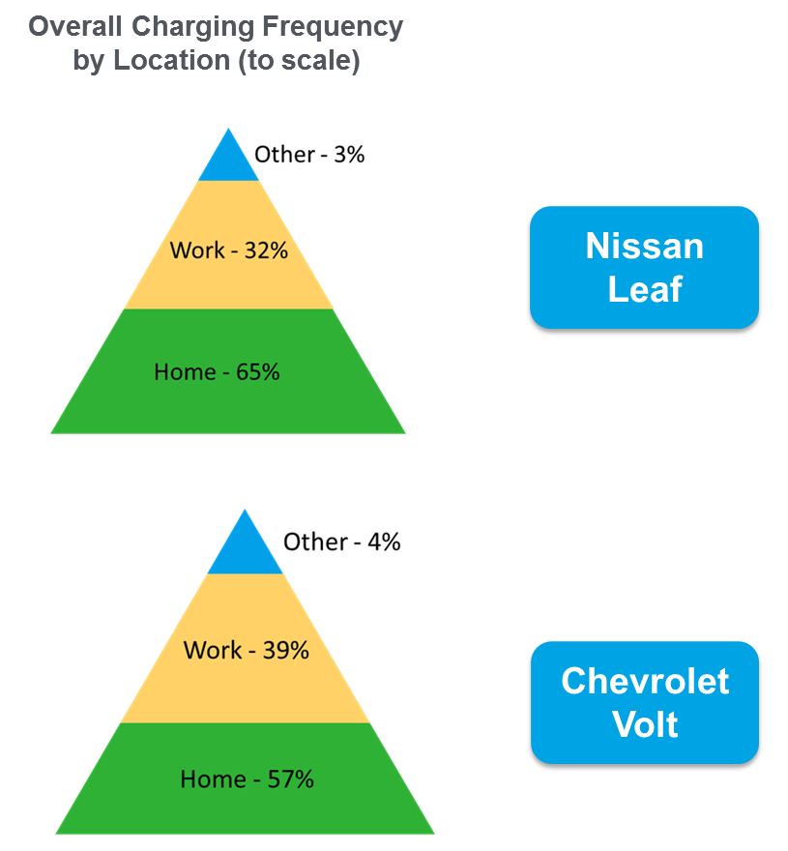
The workplace is utilized as prime charging opportunity
Source: Idaho National Laboratory for US Department of Energy, 2014
Notes:
So not only does the workplace *present* a good opportunity for workplace charging, we know that it is actually *utilized* as a prime charging opportunity.
The EV Project, DOE funded research project at the Idaho National Lab, deployed over 12,000 Level 2 charging stations and 100 DCFC. It also collected data from over 8,000 Nissan Leafs and Chevy Volts. DOE analyzed charging data from a subset of 250 of these worksites and 600+ Nissan Leafs and 100+ Chevrolet Volts that parked and charged at those worksites between 2012-2013 (1).
They found that on workdays drivers strongly preferred to charge at home and work rather than at public charging sites. They performed 98% of their charging events either at home or work and only 2% at other locations. Charging at work was free for many of these drivers, which may have been one reason why they frequently charged there (1).
(1) Idaho National Laboratory for the US Department of Energy. 2014. “Workplace Charging Frequency of Nissan Leafs and Chevrolet Volts in The EV Project at Six Work Sites.” Retrieved from: http://avt.inl.gov/pdf/EVProj/ChargingAtSixWorkSites.pdf

Slide 9
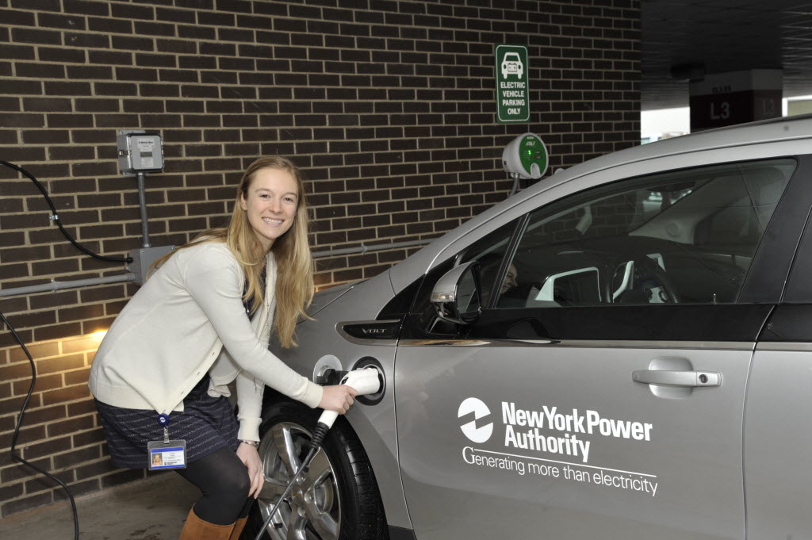

Workplace Charging is Valuable to Employees
Peer Effect
Current PEV Drivers
Increased range confidence
Increased electric vehicle miles traveled
Potential PEV Drivers
Increased PEV awareness and education
Notes:
Workplace Charging is valuable to current and potential PEV-driving employees
Not only does workplace charging address a great need for many PEV drivers, it also alleviates a significant concern for current potential PEV drivers. Workplace charging availability will help current PEV drivers by
doubling the distance an electric vehicle can drive each day, which allows for more driving spontaneity, and
adding electric vehicle miles traveled
For your other employees who are potential PEV drivers, offering workplace charging increases PEV awareness and education. As people see their coworkers plugging in, they’ll begin to realize that PEVs are practical for their daily lives.
Most importantly, workplaces serve as a second showroom, and workplace charging facilitates the peer effect. Just like colleagues like to talk about sports, movies, or travel, they will love to talk about their new car and the new charging stations in the parking lot.
Photo 1: "In 2013, the New York Power Authority (NYPA) installed three employee charging stations at its White Plains, New York, facility, as part of its workplace charging pilot program." (Photo courtesy NY Power Authority)
Photo 2: iStockphoto
[For Clean Cities’ reference]
New York Power Authority has 1,623 employees and three charging stations strictly for employee use at the main office in White Plains, NY.

Slide 10
Workplace Charging Value Proposition
95% of employers say staff has expressed satisfaction with WPC program
70% of employers have received positive recognition for their WPC efforts and 60% helped another employer develop their WPC program
Incentivizes Employees
Complements Sustainability Efforts
Signals Corporate Leadership
From 2014-2015, WPC partners saved 1.7M gallons of gasoline and 17M pounds of GHG
Notes:
It isn’t just employees who can reap the benefits of workplace charging. DOE has collected the stories of over 200 employers with workplace charging and have found time and time again that the value proposition for employers for workplace charging is quite solid.
Similar to the concept of implementing employee service benefits like a worksite fitness center or daycare, most often the return on investment comes in a non-monetary form. Benefits of workplace charging can be considered in three main categories. Workplace charging:
Incentivizes employees
Complements sustainability efforts
Signals corporate leadership
You’ll hear more about these benefits during the employer panel later today.
(1) US Department of Energy Workplace Charging Challenge Progress DRAFT Update 2015.

Slide 11

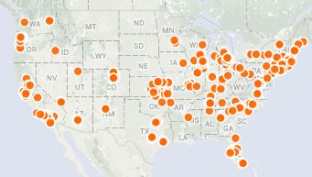
Goal: Increase the number of employers offering charging by tenfold by 2018
230+ Partner employers committing to provide EVSE for employees
5,000+ EVSE installed or planned for installation
600+ Worksites
Notes:
For those of you who may not be familiar with the Workplace Charging Challenge, it was launched by the U.S. Department of Energy as part of the president’s EV Everywhere Grand Challenge which aims to make plug-in electric vehicles as affordable and convenient as gasoline powered vehicles by 2022.
The Workplace Charging Challenge works to raise the profile of workplace charging and increase the number of partners offering PEV charging to 500 by 2018. We are moving steadily toward our goal with over 230 partners committing to provide charging station access to their employees.
These partners now represent over 600 worksites and they are providing over 5,000 workplace charging stations for nearly 1 million PEV driving employees across the country.
And some of the most exciting efforts to promote and support workplace charging are coming out of our 18 ambassador organizations and network of DOE Clean Cities coalitions

Slide 12
Commitment-based Voluntary Partnership
DOE
Workplace Charging Challenge
Ambassador
Partner
Notes:
In an effort to provide yet another benefit of workplace charging, DOE has established the Workplace Charging Challenge. With a voluntary partnership model that has proven to be successful in the past, the Challenge has three key participants:
DOE will provide employers with technical assistance and establish a network of best practices. DOE will also recognize the success of workplace charging programs and raise the profile of workplace charging.
As an Ambassador, we at <Clean Cities Coalition> are working to promote workplace charging in our community and will also support employers in their efforts to establish workplace charging programs.
And most importantly, America’s employers are called upon to act as Partners in the Challenge. As a Partner, an employer makes commitment to develop and execute a Partner Plan at a minimum of one major employer location with a best practice goal of meeting all PEV-driving employee demand.

Slide 13
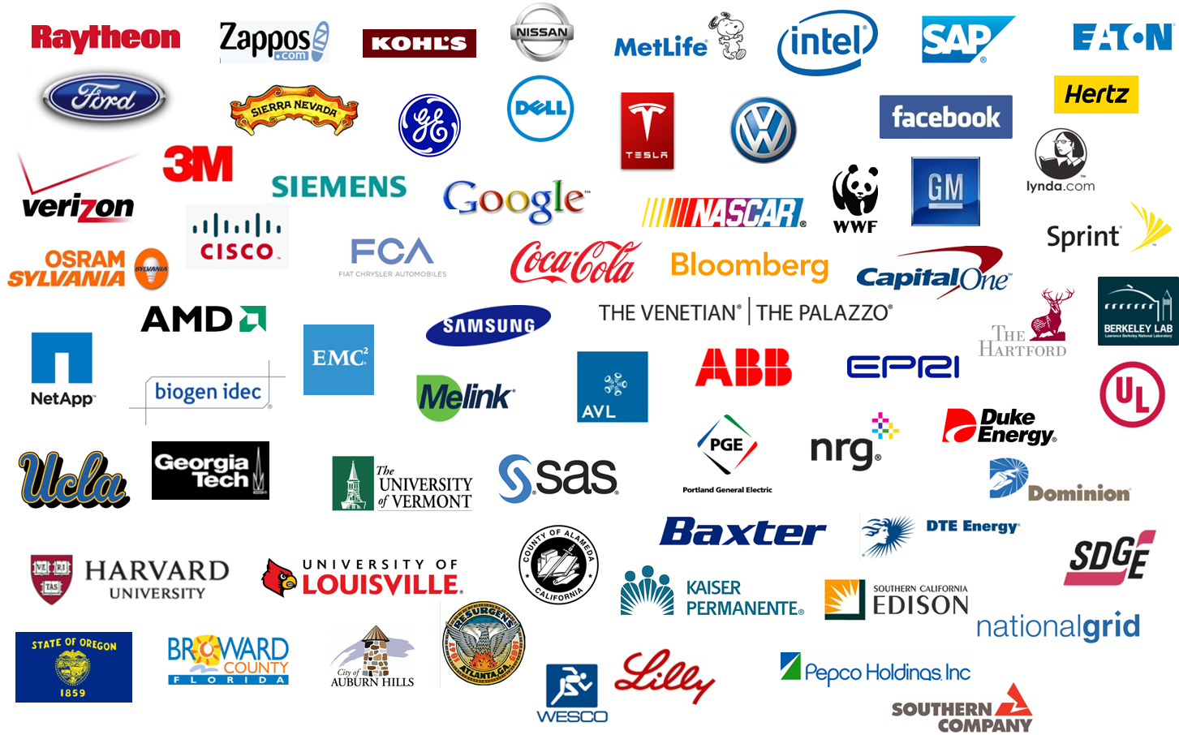
Snapshot of the 230+ Partners
Notes:
Here are some examples of Challenge partners
Leading U.S. employers have recognized the benefits of workplace charging and have taken the Workplace Charging Challenge Pledge.

Slide 14
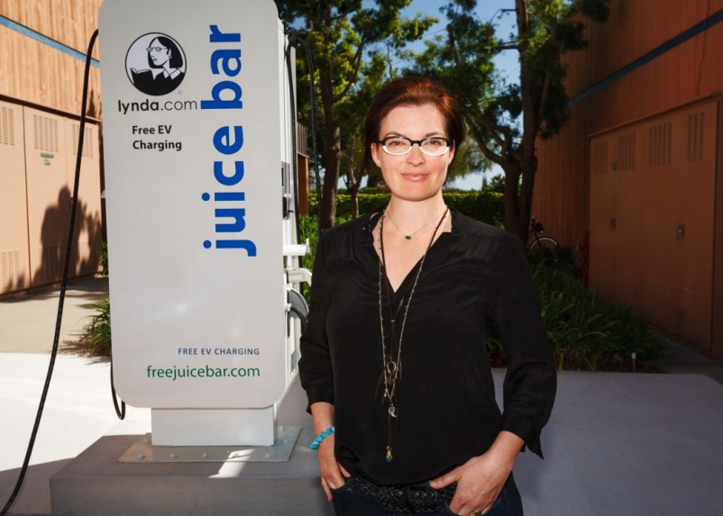
Incentivizes Employees
Incentivizes Employees
Our top candidate for the position included workplace charging as a key factor when making his decision about the job offer. We now have a charging station, a new producer, and other employees have decided to purchase EVs too. You can't put a price on that!
- lynda.com
Notes:
Workplace charging can provide a unique and valuable benefit to employees. Increasing and maintaining employee motivation remains a difficult task for executive management. Installing workplace charging can be an effective way to reward your employees and increase morale. Additionally, providing workplace charging and enabling your employees to drive PEVs can reduce their commuting stress since PEVs can qualify for HOV lane access.
How a company projects its values and ethics has become a competitive differentiator in terms of recruiting. By demonstrating concern for the environment as well as employee quality of life, employers with workplace charging are well positioned to recruit and retain top talent. So not only will installing workplace charging help increase your current employee’s performance, but it can also help position your organization for future employee recruitment.
lynda.com, a 350-person business from a small town in southern California experienced this first hand. When a top-candidate recruit said that workplace charging access would be very important in his decision-making process, lynda.com decided to look into launching a workplace charging program. In the end, they got the employee they wanted and other employees have started buying PEVs as well!
Photo: "lynda.com's PEV charging stations are part of the company's larger commuting program designed to alleviate the impact from employee commutes, which average 40 miles round-trip per day." (Photo by Lucas Deming / lynda.com)
Video: Option to replace photo with embedded version of professional-quality 2-minute video http://www.youtube.com/watch?v=inQnrbXXafw&feature=youtu.be (Video by lynda.com)
[For Clean Cities’ reference]
lynda.com has 350 employees at their Carpintera, CA location. The company’s “Juice Bar” has two 220-volt and four 110-volt outlets that charge both employee cars and the company’s fleet of small PEVs.

Slide 15
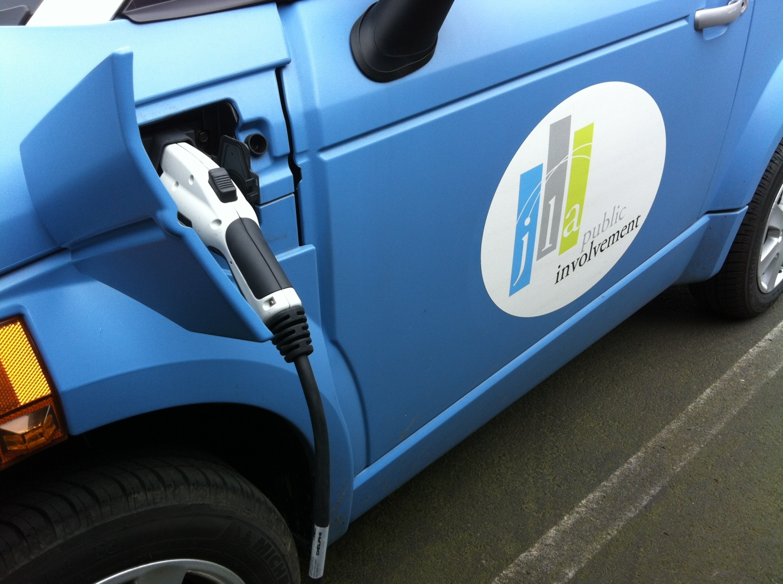
Complements Sustainability Efforts
Complements Sustainability Efforts
Purchasing a plug-in electric vehicle and installing a charging station has expanded our sustainability efforts and allowed us to achieve Gold certification in the City of Portland's Sustainability at Work program.
- JLA Public Involvement
Notes:
Integrated into your organization’s sustainability efforts, workplace charging can enhance your organization’s image and raise brand awareness, creating value for your customers, community, and investors.
Charging station installations qualify for credit under the Green Building Council’s LEED certification process, thereby contributing toward your organization’s efforts in green building (1). By accounting for the emission reductions afforded by your PEV-driving employees’ commutes, workplace charging can reduce your company’s carbon footprint (this is also known as Scope 3 emission reduction).
JLA Public Involvement is a Workplace Charging Challenge Partner and small business out of Portland, Oregon. JLA realizes that sustainability practices are important no matter the size of the organization – in fact, JLA recently received Gold certification in their city’s Sustainability at Work program. With one shared PEV and 3 employees driving plug-ins, JLA boasts a 20% adoption rate among its 15 workers!
US Green Building Council, 2009 “LEED 2009 for Core and Shell Development” http://www.usgbc.org/Docs/Archive/General/Docs8870.pdf and US Green Building Council, 2009 “LEED 2009 for New Construction and Major Renovations” http://www.usgbc.org/Docs/Archive/General/Docs8868.pdf
Photo: "JLA Public Involvement has on-site charging that is available for use both by employees' personal vehicles and by a PEV in the company's corporate vehicle pool, which can be used for all company trips." (Photo courtesy JLA)
[For Clean Cities’ reference]
JLA Public Involvement has 15 employees and 1 charging station. The charging station provides power for the company’s single company PEV as well as three personal employee PEVs.

Slide 16
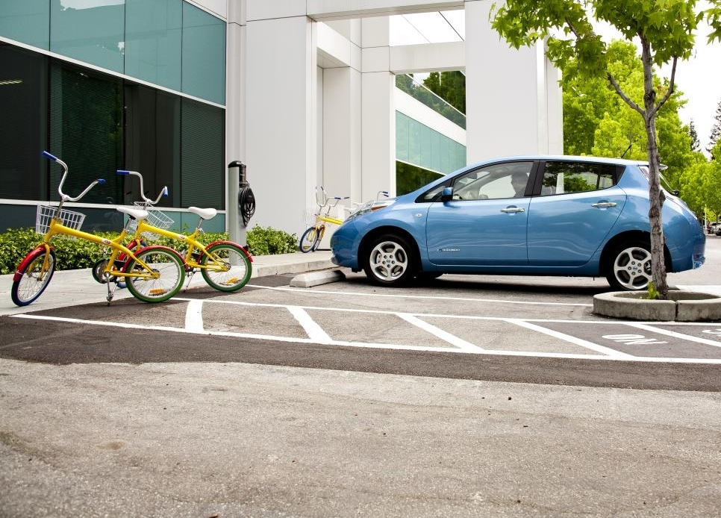
Signals Corporate Leadership
Signals Corporate Leadership
At Google, we believe that plug-in vehicles are game-changers in the effort to reduce the carbon footprint of transportation, improve air quality, and increase the adoption of intermittent renewable energy sources… We’re delighted to help drive progress in this space, and invite others to join the charge towards more EV infrastructure, cleaner air, and a sustainable future.
- Google
Notes:
Workplace charging can also enhance an innovative organizational culture by helping to develop structural and social capital. It shows your consideration and care in your employees’ work and personal lives.
It also showcases an organization’s ability to adapt, position, and prepare for the future – the charging station in your parking lot becomes a visual symbol for this mindset.
A leader in workplace PEV deployment since 2007, Google is a founding Workplace Charging Challenge Partner. Google acknowledges this leadership and encourages other employers to join their efforts. They have been a champion of sharing their lessons learned over the years and aim to eventually provide charging at 5% of their parking spaces. With more than 300 charging stations already deployed across the country, they are well on their way to their target.
Photo: "To support its corporate car share program and encourage its employees to buy their own PEVs, Google offers free workplace charging at its Mountain View headquarters and several other company locations in the United States." (Photo courtesy Google) 25,000; 300 charging stations
[For Clean Cities’ reference]
Google has 25,000 employees and 300 charging stations across the country. The company’s goal is to provide charging at 5% of its parking spaces.

Slide 17
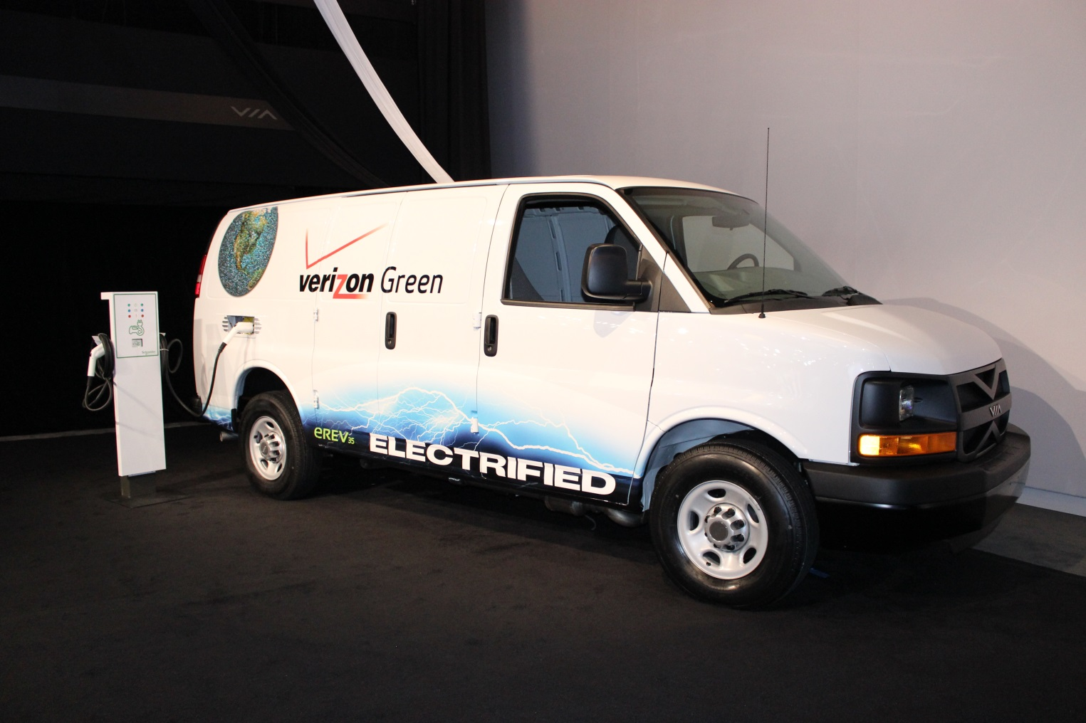
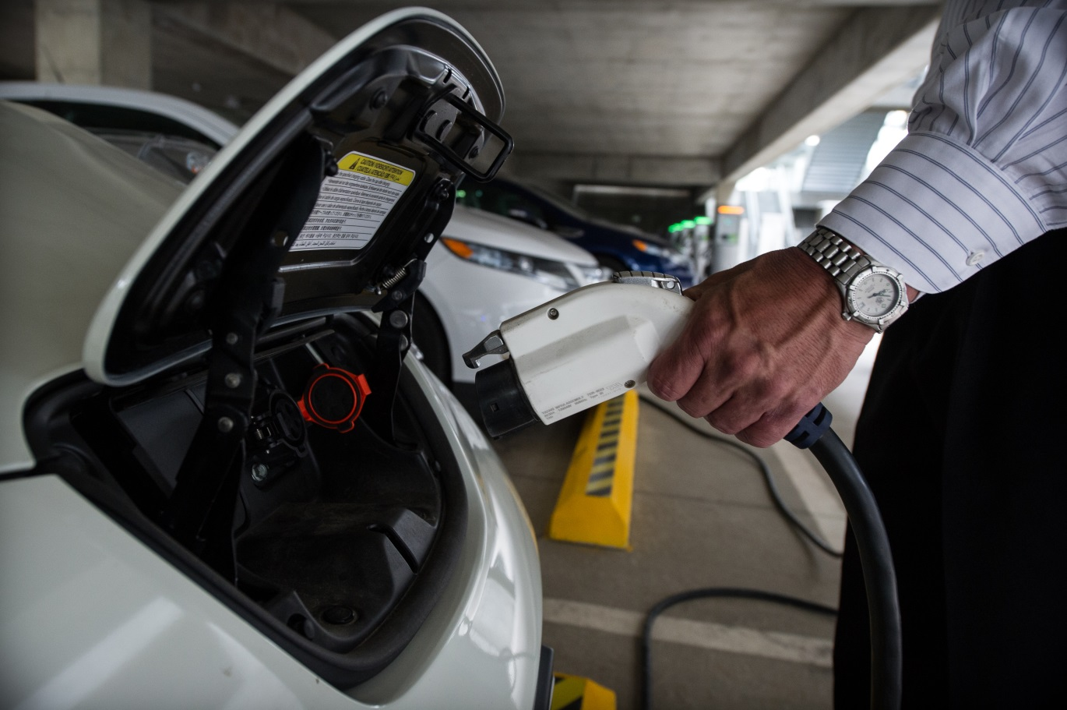
Build On Fleet Fuel Diversification
Promoting more sustainable fleets and the use of alternative fuel vehicles is part of Verizon’s commitment toward meeting ambitious sustainability goals in all areas of its business.
- Verizon
Notes:
Workplace charging can also be a great next step for organizations that are already working to integrate alternative fuel vehicles into their fleet. Through our National Clean Fleets Partnership, Verizon has increased its alternative energy vehicle fleet, composed of biofuels, compressed natural gas, hybrids and electric vehicles, to more than 2,500 vehicles (1).
Now a part of our Workplace Charging Challenge, Verizon has set its sights on expanding their charging station offerings to employees.
As a first step in gauging employee interest, Verizon surveyed members of the “Verizon Green Team,” which consists of more than 10,000 employees in 23 countries who are passionate about the improving the environment. They found that more than 80% of respondents would be more interested in purchasing an electric vehicle if they had a place to charge it at the office!
With that in mind, Verizon is casting a wider net and conducting employee surveys to determine its next locations to expand their charging station program in 2014.
US Department of Energy, 2012 “National Clean Fleets Partner: Verizon” http://www1.eere.energy.gov/cleancities/verizon.html
Photo 1: Courtesy Verizon; Photo 2: by Dennis Schroeder / NREL
[For Clean Cities’ reference]
Verizon has 180,000 domestic employees and now has three workplaces with charging stations: a retail store, data center, and call center. The amount of charging stations available at these locations has not been reported to DOE by Verizon.

Slide 18
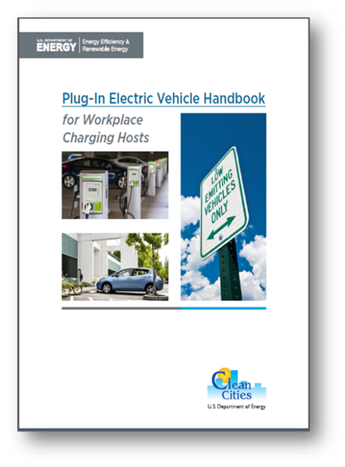
Technical Assistance
EV 101
Employer Resources
Employee Outreach Toolkit
Case Studies
Webinars
Workshops
Quarterly Newsletters
One-on-One Technical Assistance
Notes:
The Clean Cities PEV Handbook for Workplace Charging Hosts is a must-read for those considering workplace charging.
This handbook is a great 101 source for the basics of EVs and charging. It also covers assessing employee demand by using an employee survey, evaluating charging station options, best practices for installation and considerations for managing workplace charging like whether to charge a fee or provide charging for free and how to promote sharing of charging stations among employees.
As part of the Challenge, DOE dives deep into all of these topics in a number of ways to support organizations considering workplace charging. We do this through case studies, targeted resources, lots of one-on-one technical assistance and distributing resources in a quarterly newsletter.
A robust workplace charging program doesn’t end after the charging stations are in the ground. We have developed resources on how to engage employees on PEV and charging station technology.

Slide 19
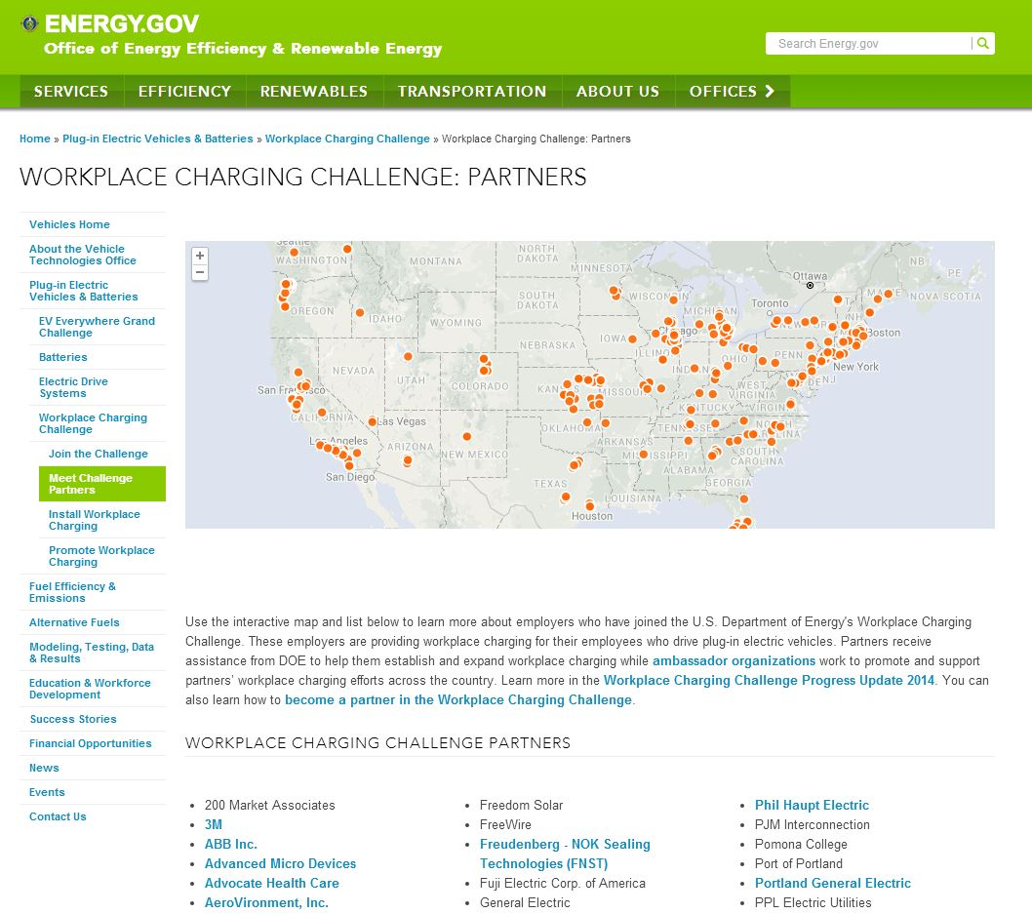
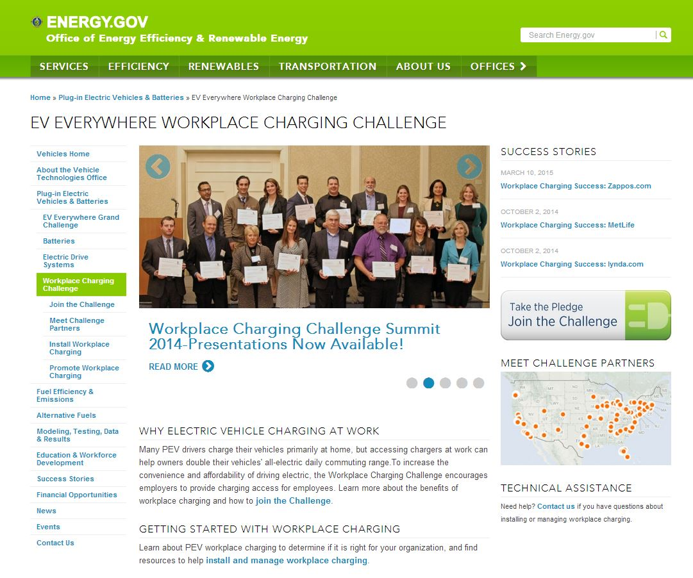
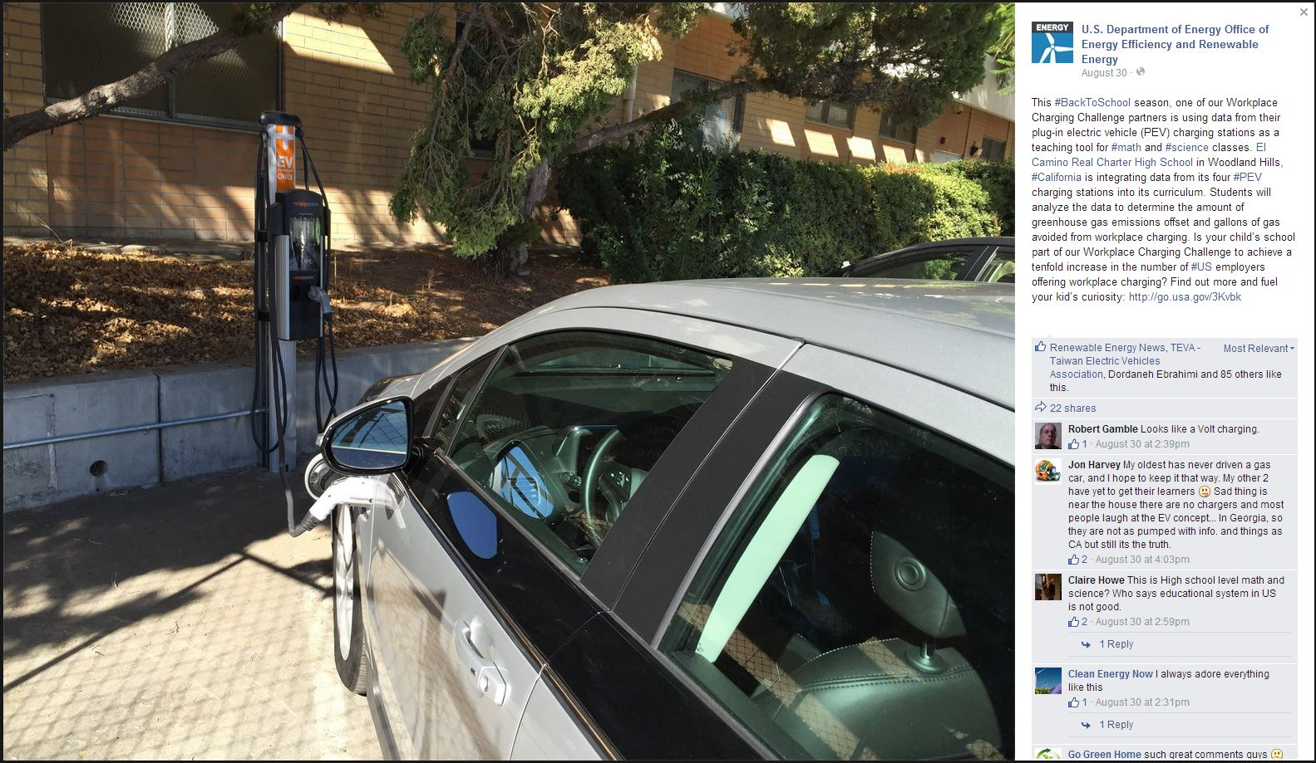
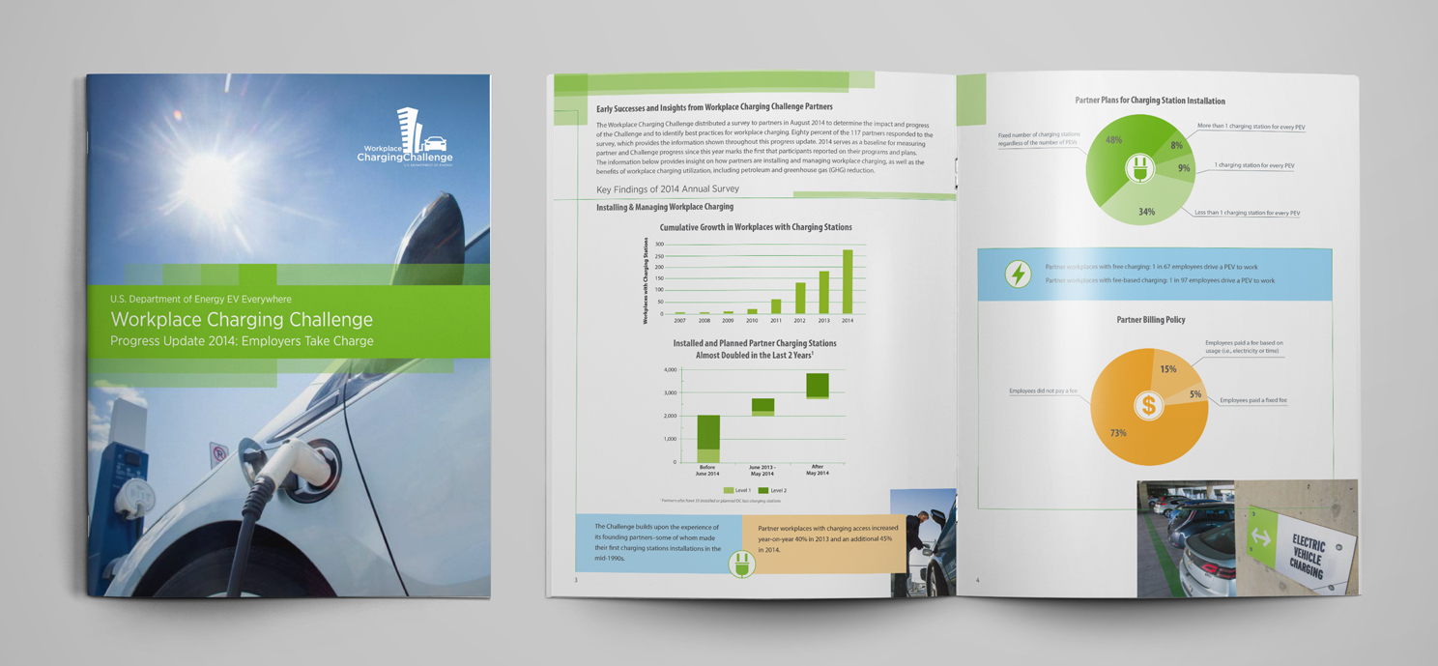
Partner Recognition
Notes:
In addition to providing technical resource assistance, the Workplace Charging Challenge aims to recognize employers for their workplace charging efforts.
The Workplace Charging Map shows where our Partners have workplace charging installed across the country. The map serves as an advertisement to current and potential PEV drivers where they can find employers in their community or industry who offer this important benefit. Attached to the Partner Map are Partner Profiles which give a snapshot of the steps that each employer is taking to implement their Workplace Charging Plan.
[CLICK ANIMATION 1] DOE is also using its communications channels to raise the profile of workplace charging and give exposure to Partner employers. This is done through speeches, press releases, national and local media interviews, blog posts and social media.
[CLICK ANIMATION 2] Innovative partners are highlighted on the EERE media outlets
[CLICK ANIMATION 3] The annual Progress Update recognizes those partners who fulfilled the previous years requirements

Slide 20
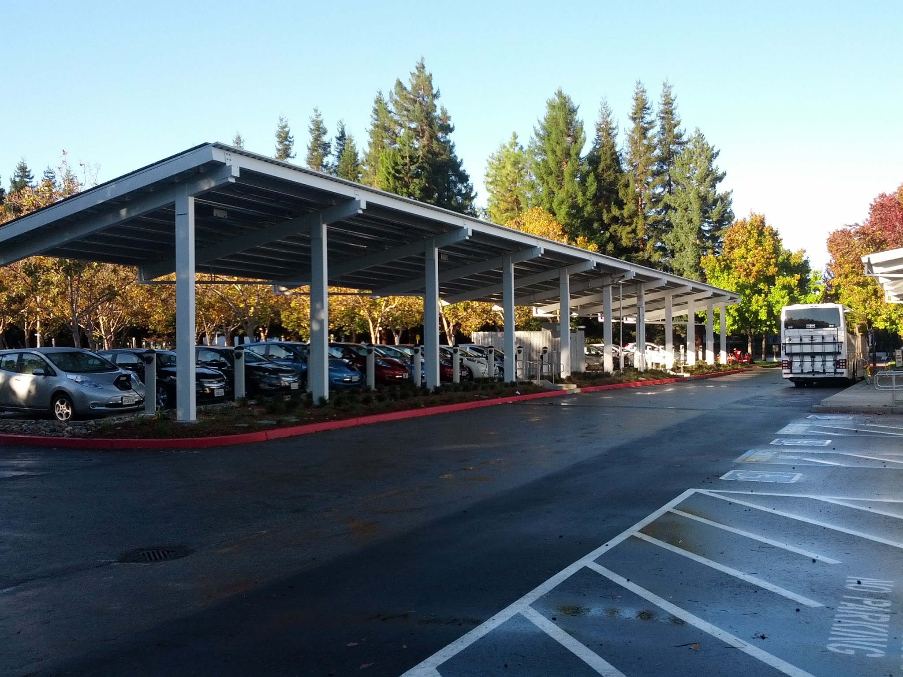
Workplace Charging Solutions
Procurement & Installation
Understanding charging station options
Understanding incentives
Working with property owners
Understanding permitting & zoning rules
Working with electrical contractors
Achieving ADA compliance
Identifying optimal signage
Notes:
As you begin to assess whether or not a workplace charging program is right for your organization, the question of “How much money, time and effort will establishing a workplace charging program cost my organization?” is very important.
Of equal importance is knowing that there are technical and potentially financial resources available – and we can help you navigate your options.
First, how much will it cost to procure and install the charging stations? There are a variety of charging stations on the market and those units vary in features and prices. Level 1 charging stations range in cost from $500 to $1,000 while Level 2 units, which can charge a vehicle faster, can cost anywhere from $500 to $7,000 (1). We can work with you to determine whether or not you are eligible for a 30% federal tax credit and find out if other state, utility and charging station provider incentives are available. Additionally, we can work with you to plan in a way that can help you minimize electrical upgrade and electrical conduit trenching costs associated with the installation process.
If your worksite is on leased property, working with property owners can be challenging, as can understanding our areas permitting and zoning rules for charging station installation. Since we’ve worked with others on these issues before, our Clean Cities coalition can help make this process easier. DOE and Clean Cities have even created videos to assist electrical professionals during the installation process.
Lastly, it is important to understand how to achieve ADA compliance and identify optimal signage for your charging station parking spots. While these are both issues that are still evolving, our coalition is working with other coalitions across the country to find out what is working best in other communities.
US Department of Energy Plug-In Electric Vehicle Handbook for Workplace Charging Hosts, 2013
Photo: "With more than 300 charging stations already deployed across the country, Google's goal is to provide charging at 5% of its parking spaces." (Photo courtesy Google)
[For Clean Cities’ reference]
Google has 25,000 employees and 300 charging stations across the country. The company’s goal is to provide charging at 5% of its parking spaces.

Slide 21
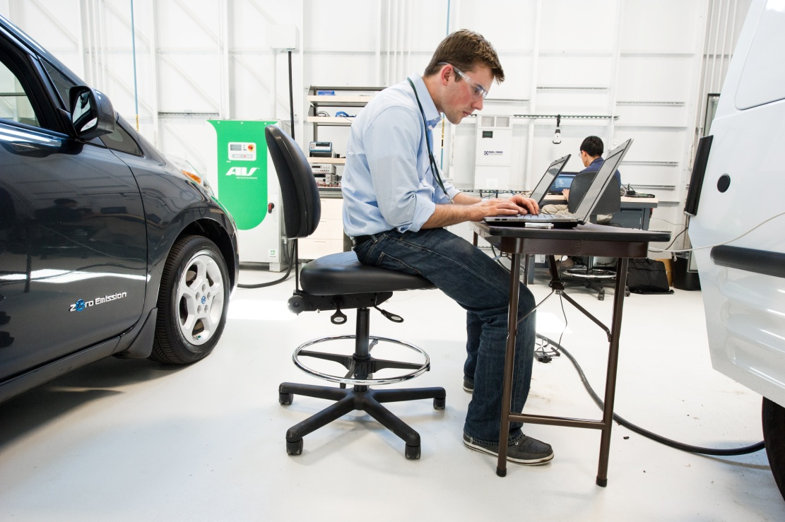
Workplace Charging Solutions
Management & Policy
Monitoring electricity & usage
Setting an employee pricing system
Establishing employee fairness
Working with utilities on demand charges
Determining management logistics
Communicating legal liability
Developing parking etiquette
Notes:
As you start to get your charging stations up and running, you’ll consider, “How will I develop an internal management system and policy that integrates seamlessly into my organization’s operations?”
It may be surprising to hear that the electricity used by a workplace charging station is minimal – in fact, it will cost an average of a only $34 per month per employee (1). Your organization may choose to mitigate these costs by charging your employees a fee for their electricity usage. We can work with you to evaluate the provision of free electricity to your employees, how much you should charge if you decide to do so and discuss the employee fairness and tax implications of these options. We can also work with you and your utility to understand potential demand charges as well.
Employers face unique and potentially time-consuming challenges when determining how the units will be managed, how you will communicate with your insurer on worksite charging safety, and how you will establish a worksite parking and charging etiquette among your employees. Other issues unique to your organization or worksite may also arise over the lifetime of your workplace charging program. But by working with our Clean Cities coalition and taking advantage of the best practices and technical assistance of the Workplace Charging Challenge, the task of developing a workplace charging program management and policy can be eased.
(1) US Department of Energy Vehicle Technologies Office, 2013
Photo: “NREL intern Josh Crowley and NREL engineer Myungsoo Jun, run an experiment at the Vehicle Testing and Integration Facility (VTIF).” (Photo by Dennis Schroeder / NREL)

Slide 22
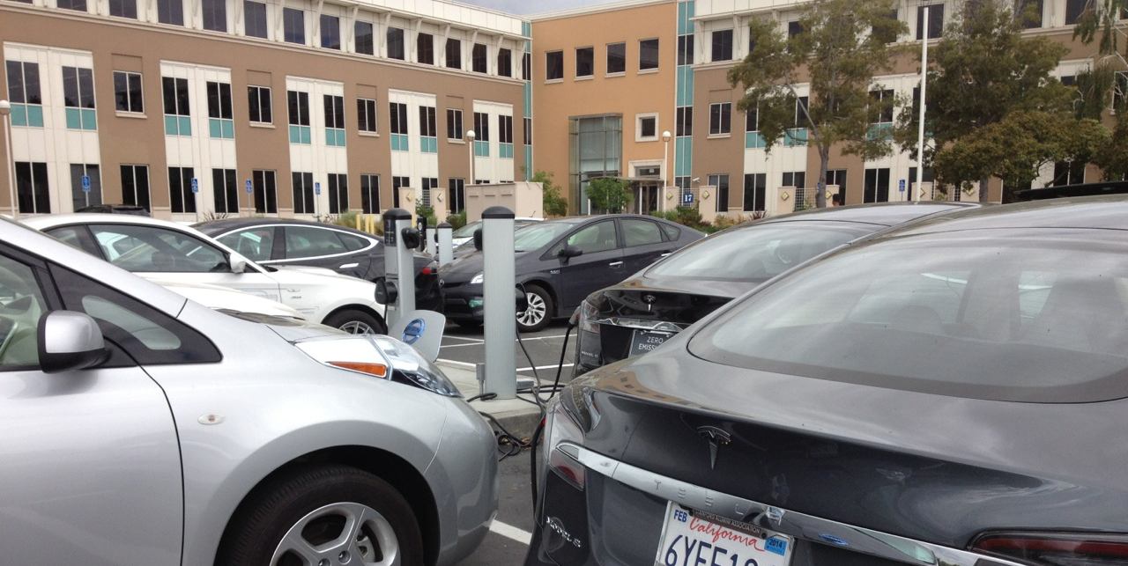
Workplace Charging Challenge Partner Plan
Program Background
Goals and Progress
Demand Assessment
Procurement & Installation
Management & Policy
Activity or Programs
Notes:
If you choose to join the other employers in the Workplace Charging Challenge, we’ll work to integrate the considerations discussed on the previous two slides into your “Partner Plan.” In the Plan you will set goals, measure progress, and assess demand for charging stations. Developing this plan will help minimize barriers and smooth the way towards installing workplace charging at your organization.
Photo: "As part of Facebook's aggressive Transportation Demand Management (TDM) program, the company has committed to supplying free PEV charging to its Menlo Park, California, employees." (Photo by Lauren Bonar Swezey / Facebook)
[For Clean Cities’ reference]
Background and Goals/Progress: What is your company’s long-term vision for your WPC program and how will you track progress?
Demand Assessment: How will your company assess your employee’s demand for WPC?
Management/Policy: How will your company’s WPC program be integrated into an effective internal company policy?
Procurement/Installation: How will your company evaluate charging station options and work to install WPC?
Activity/Programs: What other ways is your company working to promote the deployment of EVs?
[For Clean Cities’ reference]
Facebook has 4,500 employees, Currently, the campus has 1 DC Fast Charger and 25 Level 2 charging stations, with plans to install 12 more in 2013. Facebook has also made 21 Level 1 charging stations available to its employees.

Slide 23


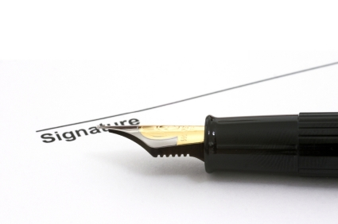
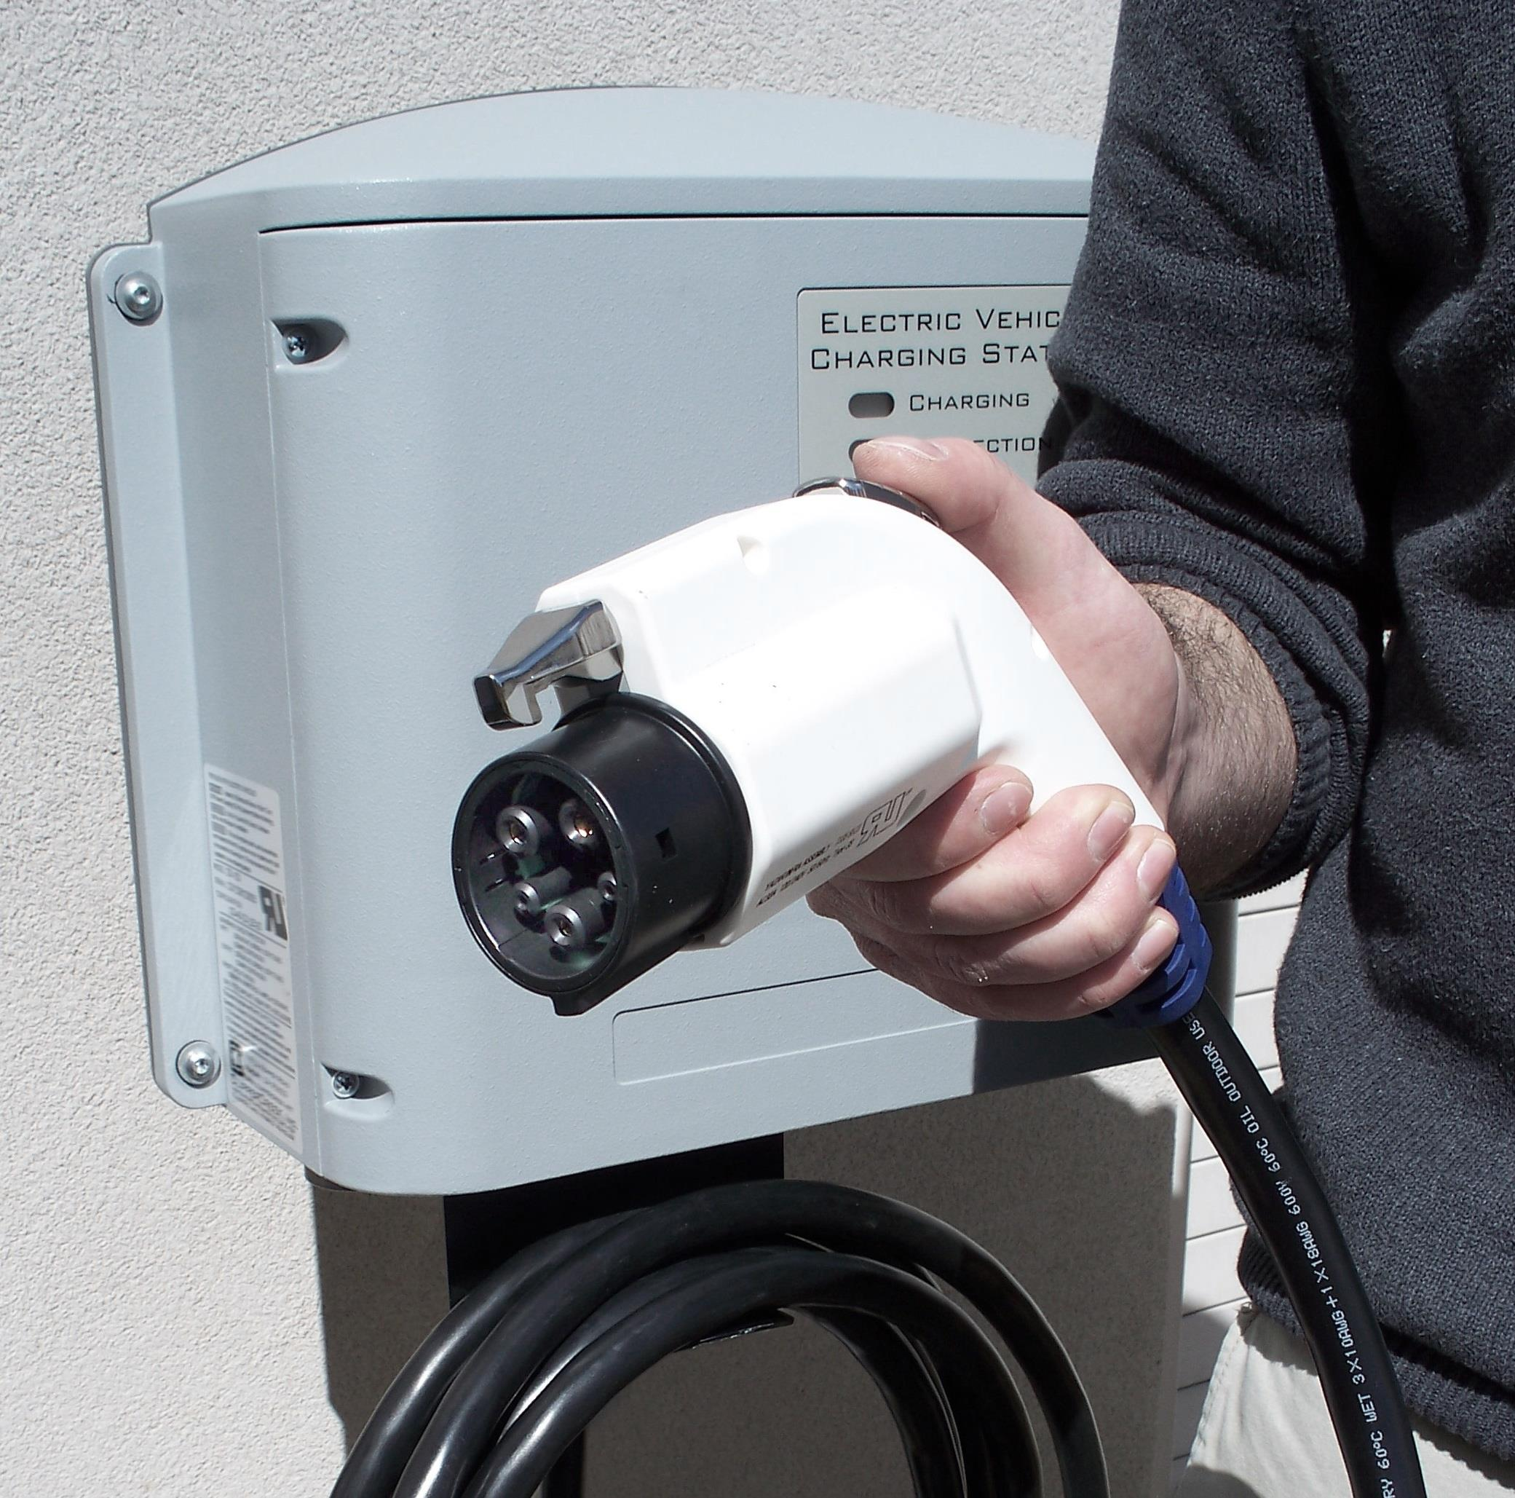
Is Workplace Charging Right for You?
Let’s continue the conversation
Learn more about the Workplace Charging Challenge
Build a successful workplace charging program
Notes:
Ultimately, the amount of money, time and effort that goes into a workplace charging program will vary from organization to organization. Yet many employers that have joined the Workplace Charging Challenge have found the business case combined with the employee and societal benefits to be very compelling. And the benefits of DOE’s Challenge program and having our support doesn’t hurt either!
As for next steps, let’s continue the conversation. We have a wealth of technical resources and experience that can help you determine if workplace charging is a good fit for your organization. The PEV Handbook for Workplace Charging Hosts (pictured here) is a brand new resource that we just released that provides a great introduction to worksite charging. It even provides a sample survey that you can use to start a conversation with employees and gauge their interest in charging at work.
If your organization decides that workplace charging is right for you, we can work with DOE’s Workplace Charging Challenge Coordinator to learn more about becoming a Partner employer.
And as you develop your workplace charging program, we’ll help you overcome challenges, amplify your success, and share best practices with other employers.

Slide 24
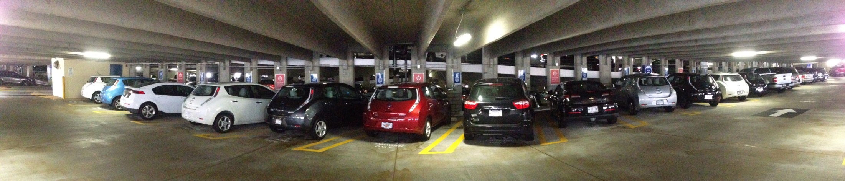
Let’s Continue the Conversation
Presenter’s Name
E-mail address
Phone number
Workplace Charging Challenge
WorkplaceCharging@ee.doe.gov
www.electricvehicles.energy.gov
Clean Cities
www.cleancities.energy.gov
Notes:
In a time of fluctuating petroleum prices and heightened environmental concerns, many workers see PEVs as a convenient way to reduce driving costs and environmental impacts.
The number of PEVs on U.S. roadways is increasing rapidly, as is the need for charging infrastructure.
Now is a good time to consider hosting workplace charging and becoming a leader in the electrification of transportation.
Thank audience and Q & A
Photo: “After installing 12 Level 1 EVSE charging stations at its headquarters office, Coca-Cola employees have told the company they are making the choice to buy plug-in electric vehicles (PEVs) based on the company's support.” (Photo courtesy The Coca Cola Company)
[For Clean Cities’ reference]
Coca Cola has 71,000 employees with 5,000 at their U.S. headquarters in Atlanta, GA. They 12 Level 1 charging stations as of September 2013.

